Slide 1
Tea-Mates

Slide 2
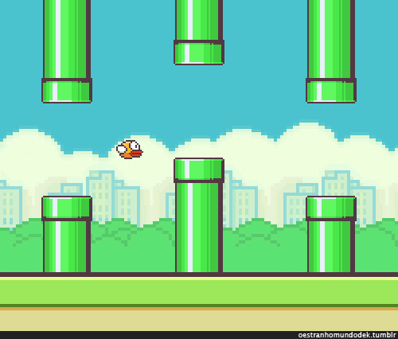
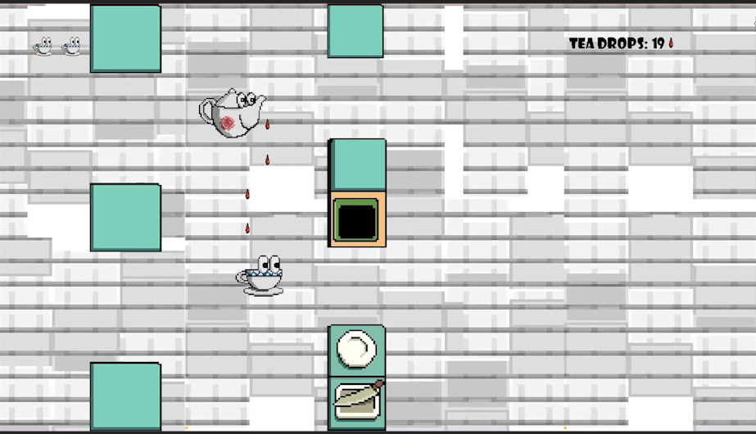
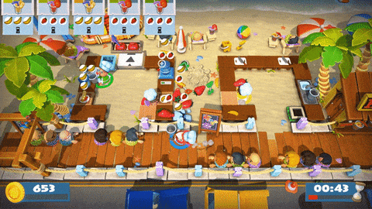



What is Tea-Mates?
Two player co-op
A challenging obstacle course
Delivery and Refilling system

Slide 3





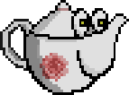
Concept Art
Please enjoy the hard work of our art team

Slide 4
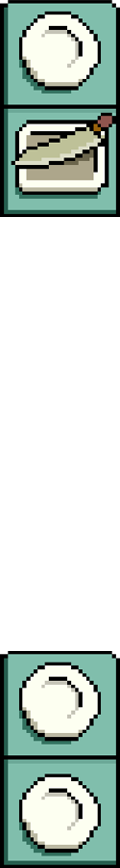


Rules
Health system
Collisions
Limited tea amount
Main objective

Slide 5
Upcoming Features
Short-term Plans
Long-term Plans
More Collisions
General UI improvements
New Maps
Tea Types
Multiple delivery zones

Slide 6

Come By And Play Some Time

